Slide 1
Go on and
A crash course on Git for the DHHS R User Group
Michael Valcic
9/9/2024

Slide 2
Overview
What’s version control and why use it?
Why Git and not something else?
Git and GitHub
Some useful Git commands
Demo example with an internal remote repository for an R project

Slide 3
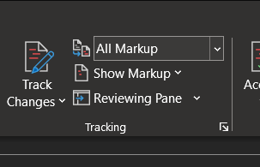
What’s version control?
Version control is the practice of tracking and managing changes on projects across time.
Think of Word’s Track Changes feature as a simplistic example:
It allows for ease of:
Controlling Collaboration
Managing Releases
Providing Backups
Maintaining Change History Logs
Notes:
Collaboration:
Enables multiple developers to work on the same project simultaneously without conflicts.
Facilitates branching and merging, allowing parallel development of features
Backup and Recovery:
Provides a safety net against data loss by maintaining backups of all versions.
Allows recovery of previous versions in case of errors
Release Management:
Simplifies the process of managing different versions of software releases.
Ensures that only tested and approved changes are included in the final product
History:
Keeps a detailed history of changes, including who made them and why.
Helps in identifying and reverting problematic changes

Slide 4

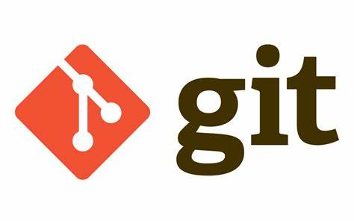

Why Git?
Beyond Git: The other version control systems developers use - Stack Overflow

Slide 5
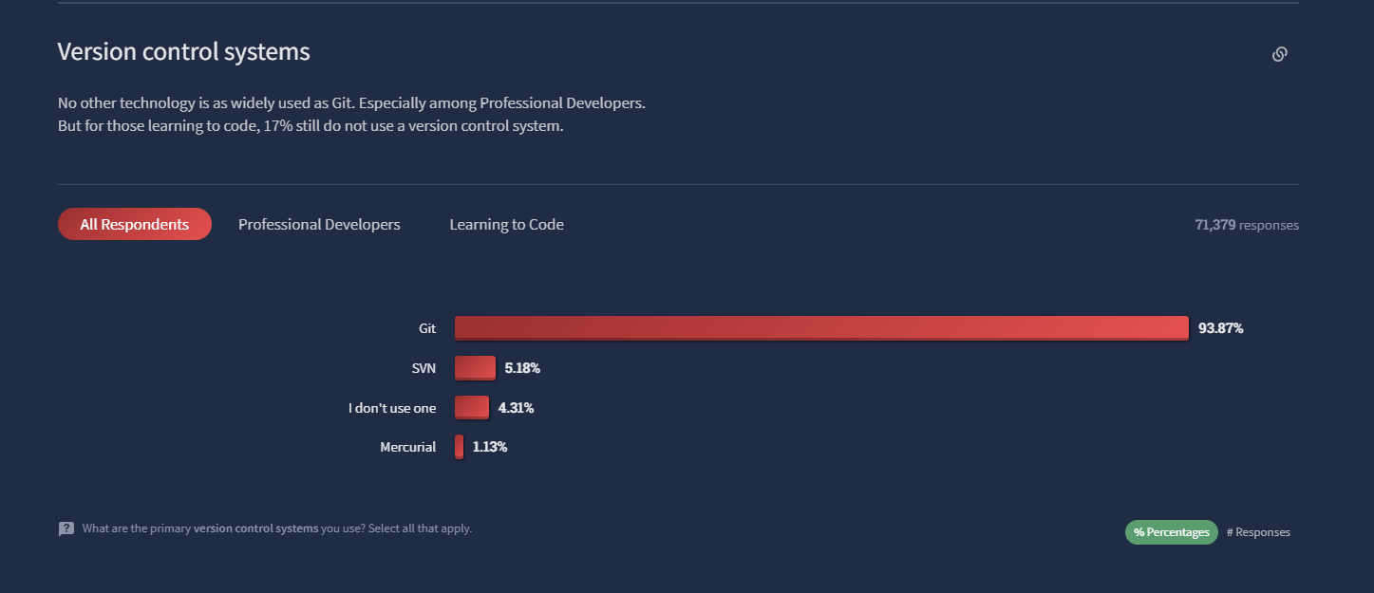
Why Git?
Notes:
Stack Overflow Developer Survey 2022

Slide 6
Git != GitHub
They are distinct, but complimentary!

Slide 7
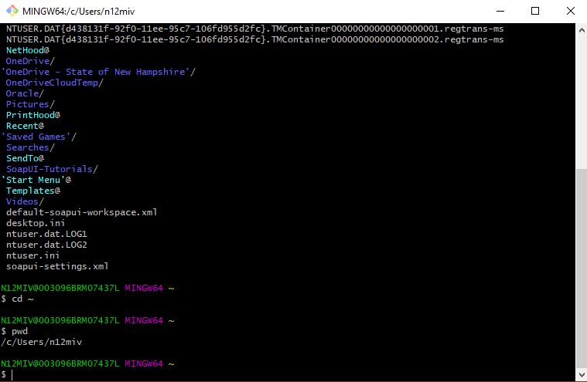
Git Bash
Notes:
Unix Command Line Features: Git Bash includes a Bash emulation, which is a popular default shell on Linux and macOS. This allows you to use Unix command line tools on Windows.
Git Commands: It provides a command-line interface (CLI) for Git, enabling you to run Git commands and interact with repositories.

Slide 8
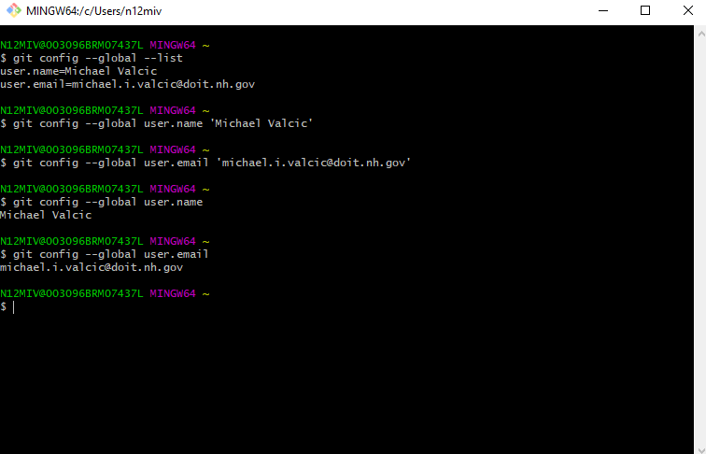
Config Stuff

Slide 9
Our basic recipe is here:

Slide 11
Useful links
A successful Git branching model » nvie.com
50 Git Commands You Should Know (freecodecamp.org)
GitCheatSheet (github.com)
Git Tutorial (w3schools.com)

